Slide 1
The work done so far
Hungary

Slide 2
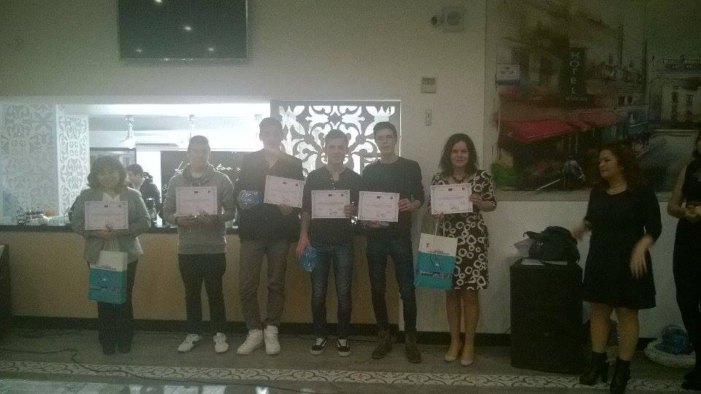
Evaluation the meeting in Turkey

Slide 3
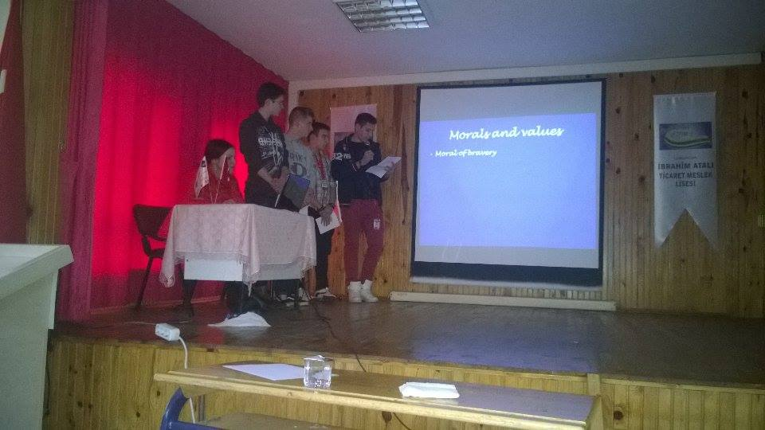

Slide 4
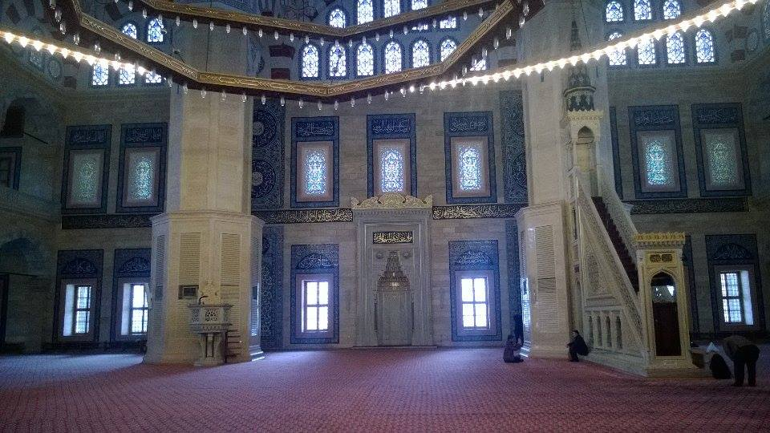

Slide 5
Completing our chapter for the book and photo album
Preparing the meeting in Hungary
Parents council
Organizing the programmes

Slide 6


