Slide 1
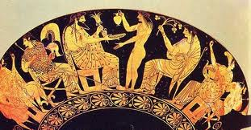
“Discovering my own mythologυ””
6th College of Lamia
Greece

Slide 2
the most important fabulous things representative for the national literature

Slide 3
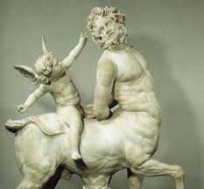
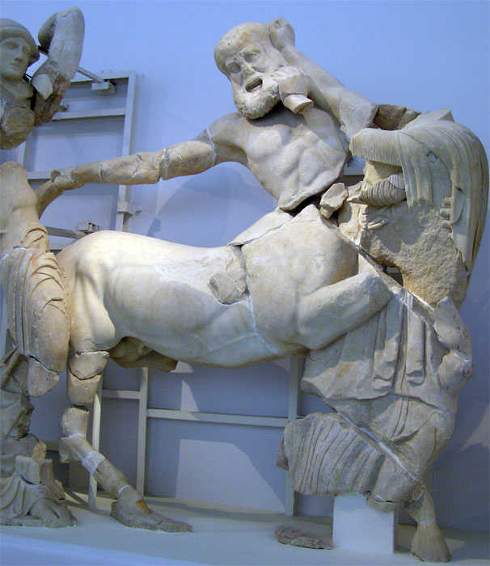
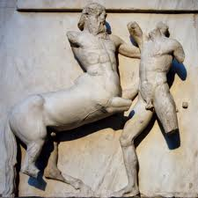
centaur

Slide 4
the most important heroes from folk mythology representative for national cultural space

Slide 5
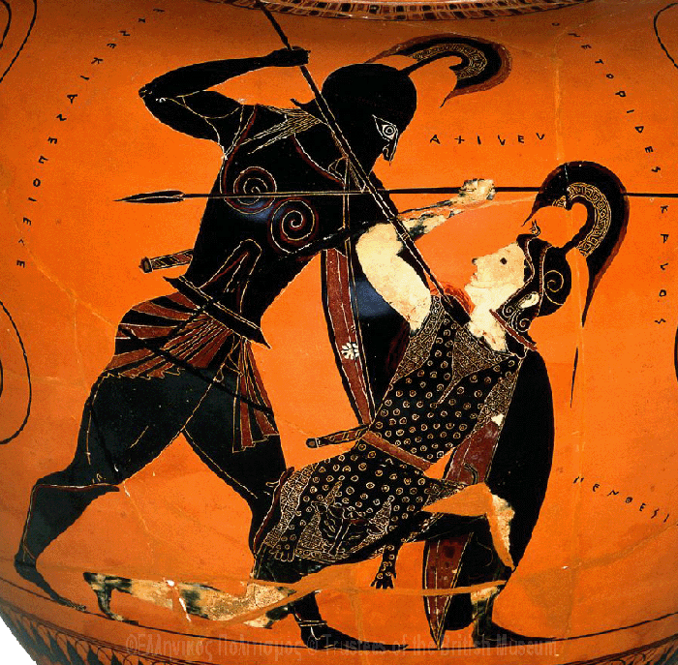
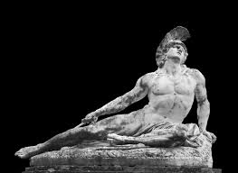
achilles

Slide 6
the most known rituals found in national mythology

Slide 7
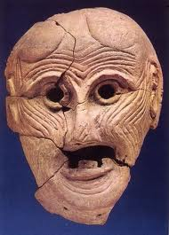
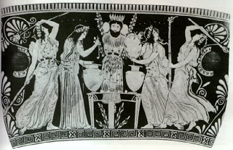
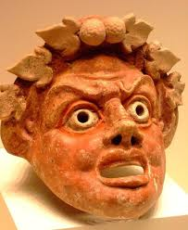
apokries-dionysian rituals

Slide 8
THE MOST REPRESENTATIVE FOR MY NATIONAL CULTURAL SPACE

Slide 9
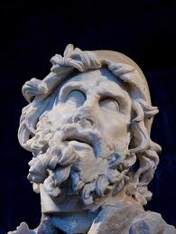
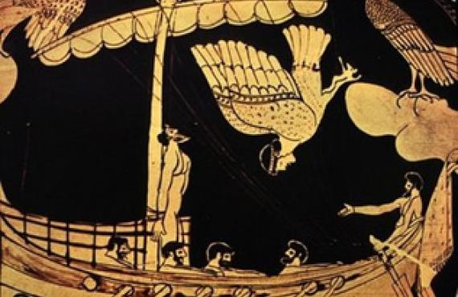
ODYSSEY

Slide 10
part 2

Slide 11
THE NATIONAL LITERARY FOLK WORK MOST REPRESENTATIVE FOR EACH INDICATED MYTH

Slide 12
THE ETHNO GENESIS MYTH

Slide 13
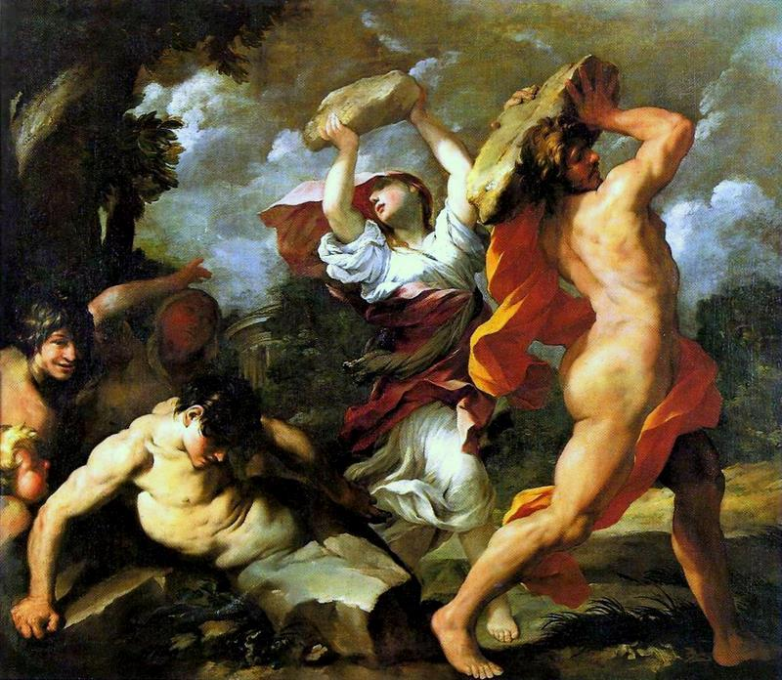
THEOGON (HESIOD)
DEUCALION - PYRRHA

Slide 14
THE MYTH OF SACRIFICE

Slide 15
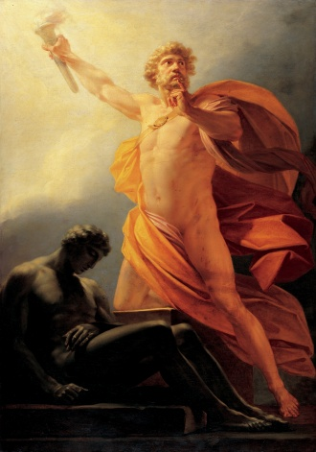
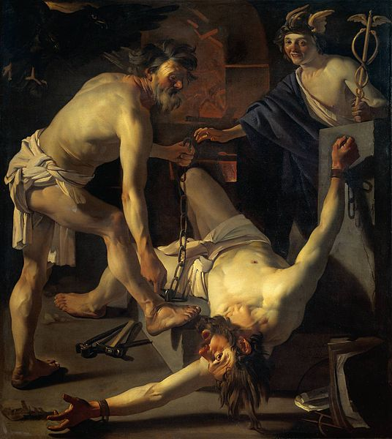
PROMETHEUS BOUND

Slide 16
THE MYTH OF LOVE

Slide 17
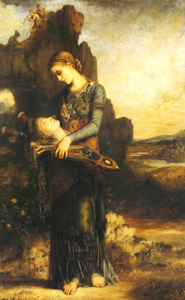
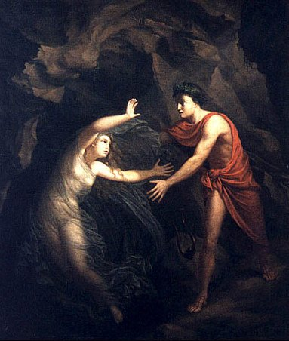
ORPHEUS AND EYRYDICE

Slide 18
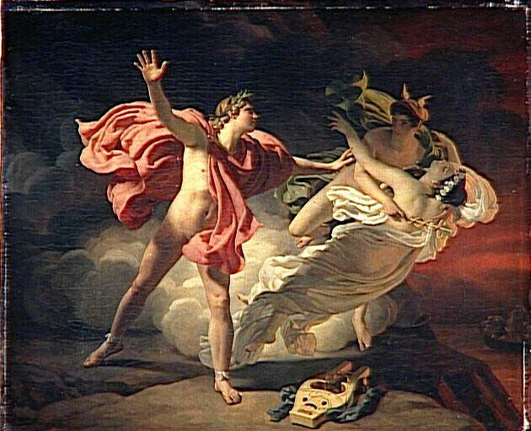
ORPHEUS AND EYRYDICE

Slide 19
THE MYTH OF NOSTOS OF ODYSSEUS

Slide 20
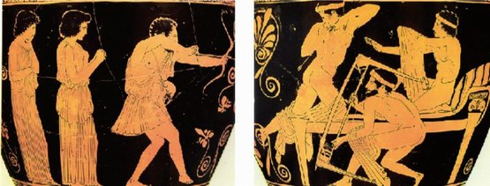
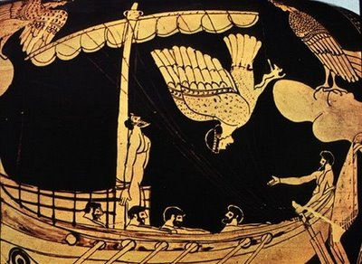
ODYSSEUS’ RETURN(Nostos)

Slide 21
THE NATIONAL CULT LITERARY WORK WHICH ARTISTICALLY TRANSPOSES THE INDICATED MYTH

Slide 22
THE ETHNO GENESIS MYTH OF ORIGIN

Slide 23
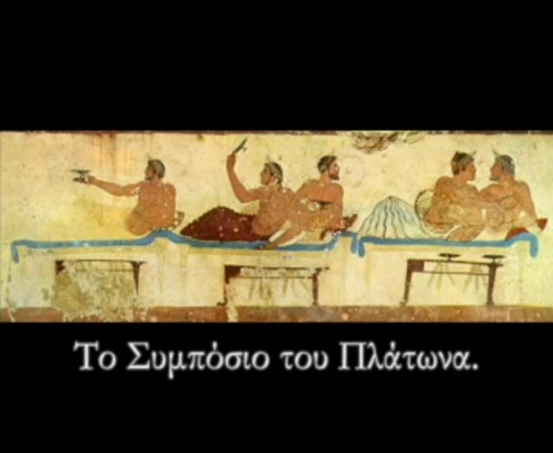
SYMPOSIUM (Plato)

Slide 24
THE MYTH OF PROTAGORAS

Slide 25
THE MYTH OF SACRIFICE FOR CREATION

Slide 26
THE MYTH OF LOVE

Slide 27
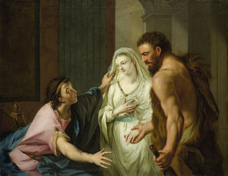
ALCESTIS

Slide 28
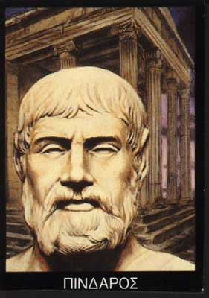
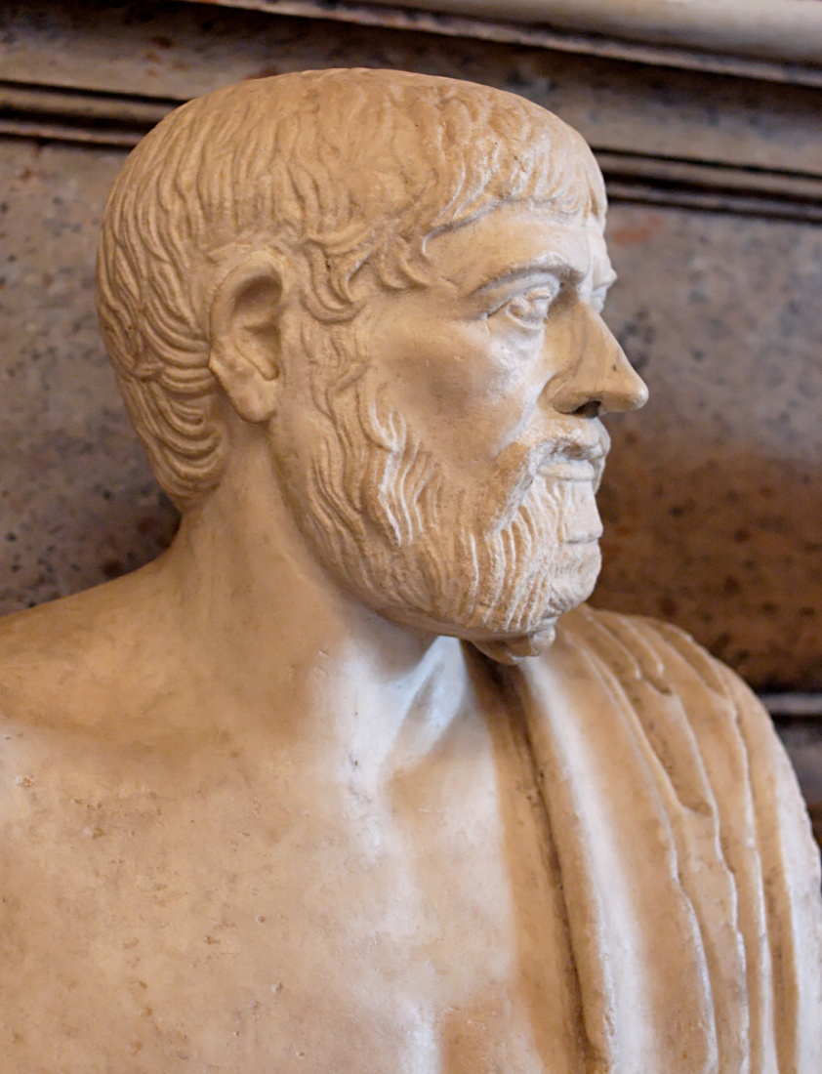
PINDAR(Laments)

Slide 29
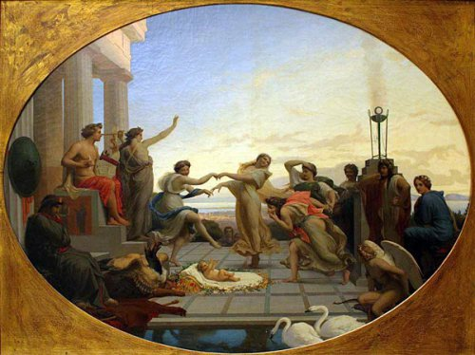
THE birth of pindar

Slide 30
THE MYTH OF NOSTOS OF ODYSSEUS

Slide 31
Ithaca (Constantine P. Cavafy)

Slide 32
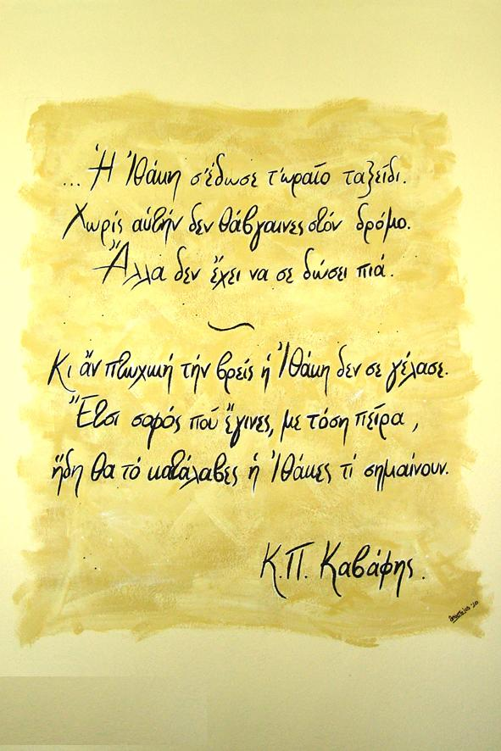
Ithaca (Constantine P. Cavafy)

Slide 33
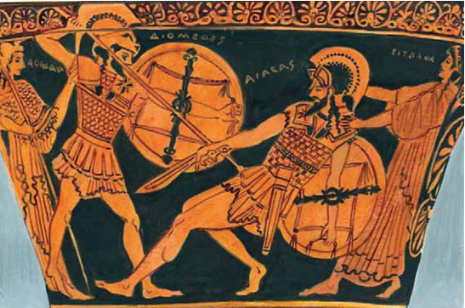
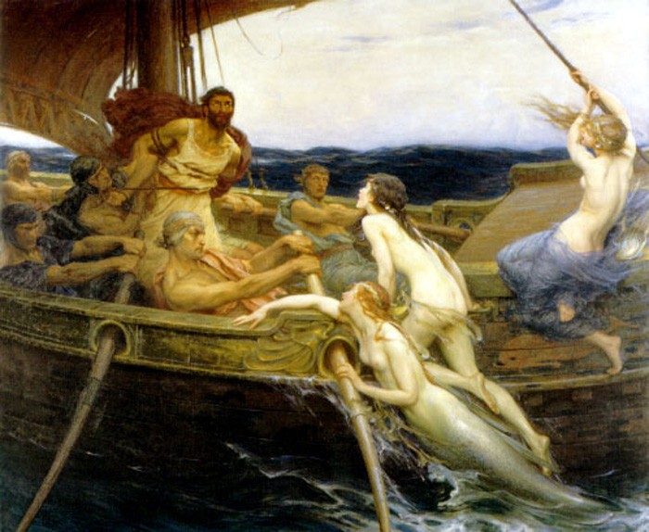
Homeric poems

Slide 34
Odyssey (Nikos Kazantzakis)

Slide 35
THE NATIONAL FILM OR A PLAY MOST
REPRESENTATIVE
FOR EACH INDICATE

Slide 36
THE ETHNO GENESIS MYTH OF ORIGIN

Slide 37
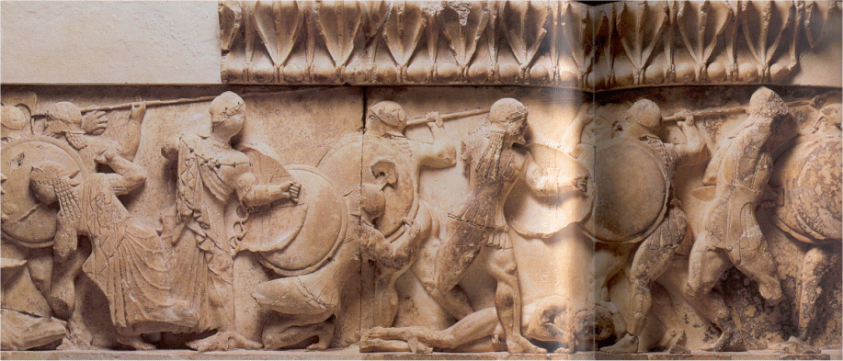
Wrath of the Titans

Slide 38
THE MYTH OF SACRIFICE FOR CREATION

Slide 39
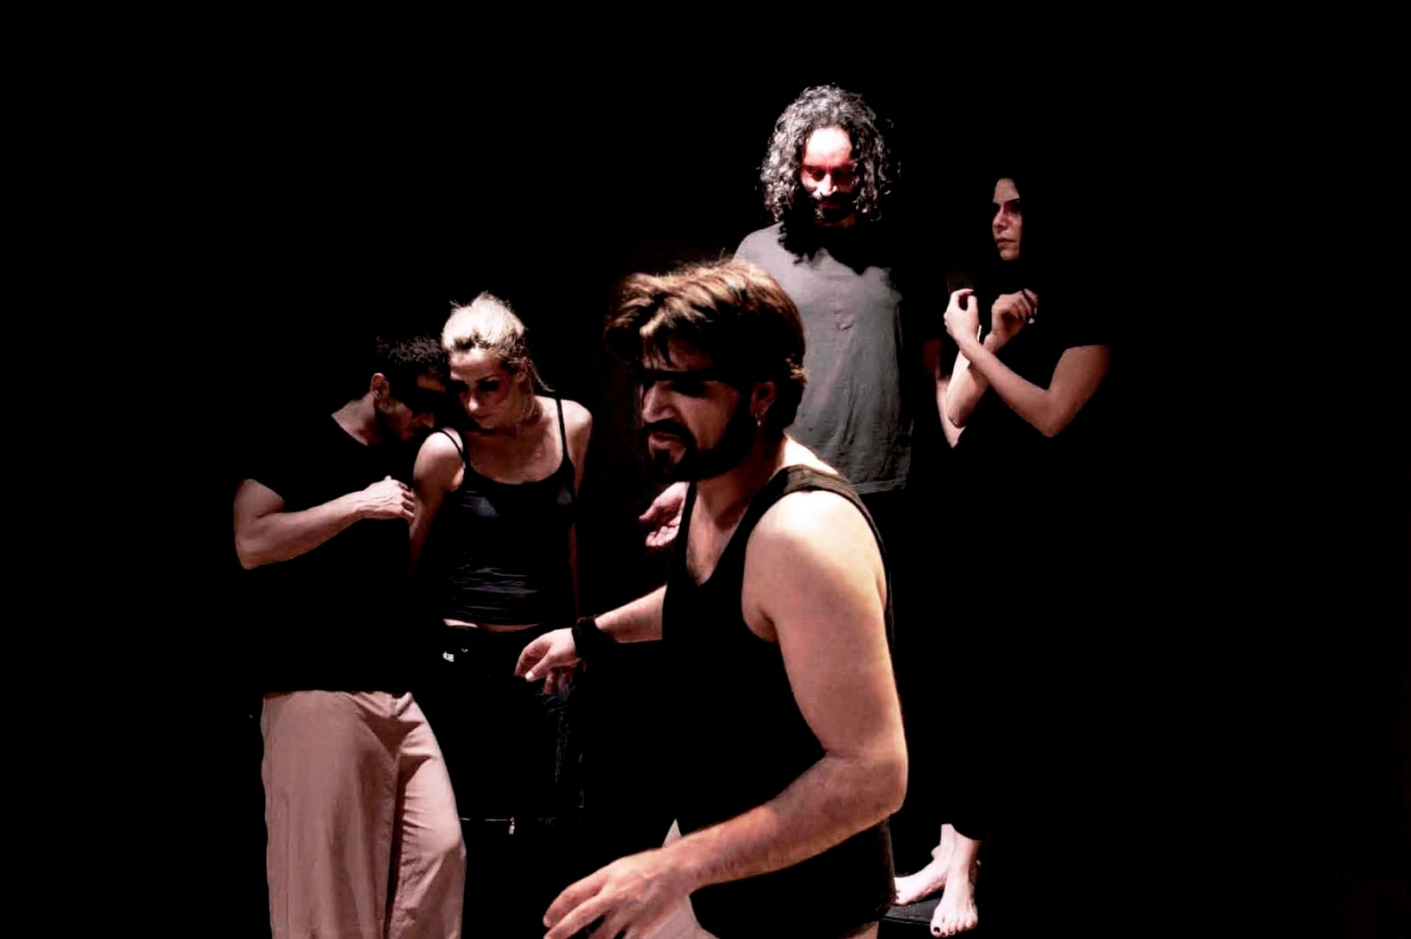
Prometheus Bound

Slide 40
THE MYTH OF LOVE

Slide 41
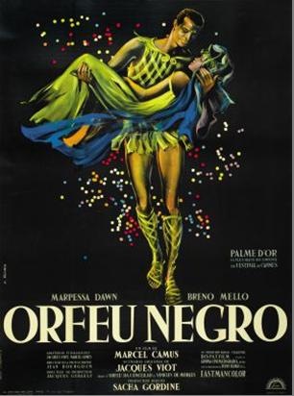
orfea negro

Slide 42
THE MYTH OF NOSTOS OF ODYSSEUS

Slide 43
ULYSSES’ GAZE

Slide 44
THE NATIONAL VISUAL ARTISTIC CREATION MOST REPRESENTATIVE FOR EACH INDICATED MYTH

Slide 45
the ethno genesis film

Slide 46
the myth of sacrifice for creation

Slide 47
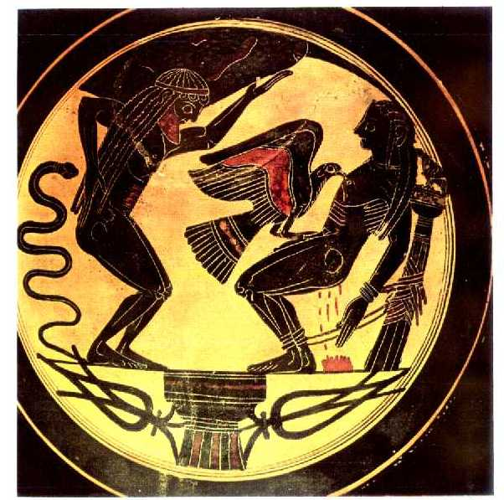
the promethEus on caucasus

Slide 48
the myth of love

Slide 49
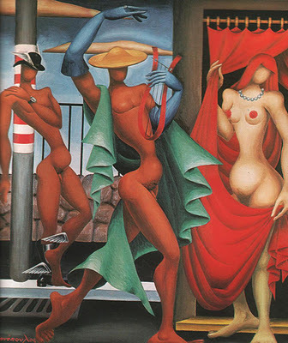
ORPHEUS AND EURYDICE (NIKOS ENGONOPOULOS)

Slide 50
the myth of NOSTOS OF ODYSSEUS

Slide 51
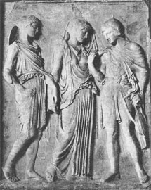
ORPHEUS, EURYDICE AND HERMES

Slide 52
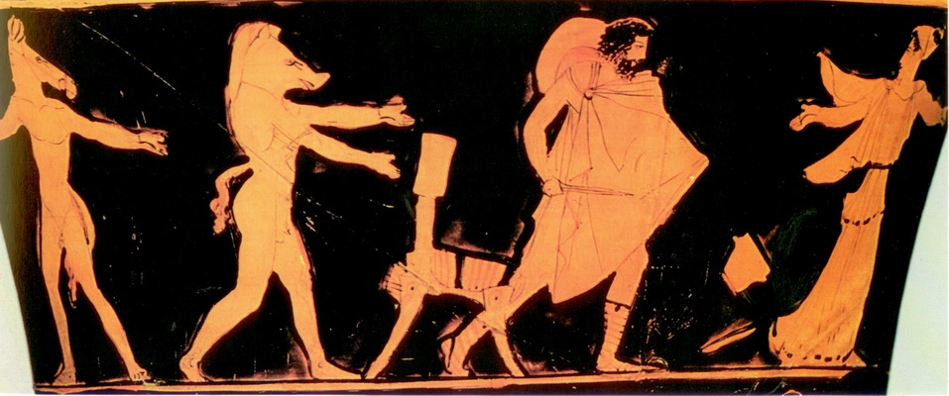
Odysseus' return (nostos)

Slide 53
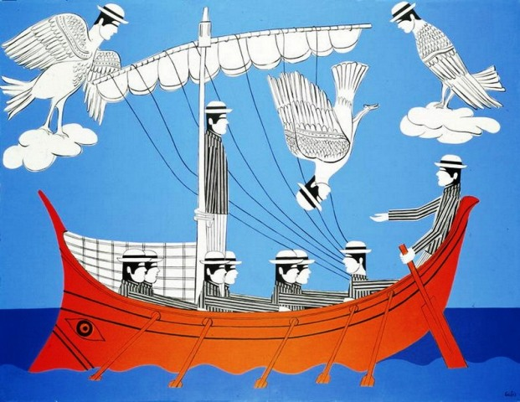
odysseus and sirens(giannis gaitis)

Slide 54
thANK YOU FOR ATTENTION

