Slide 1
Szily Kálmán Technical Vocational Secondary School, Budapest

Slide 2
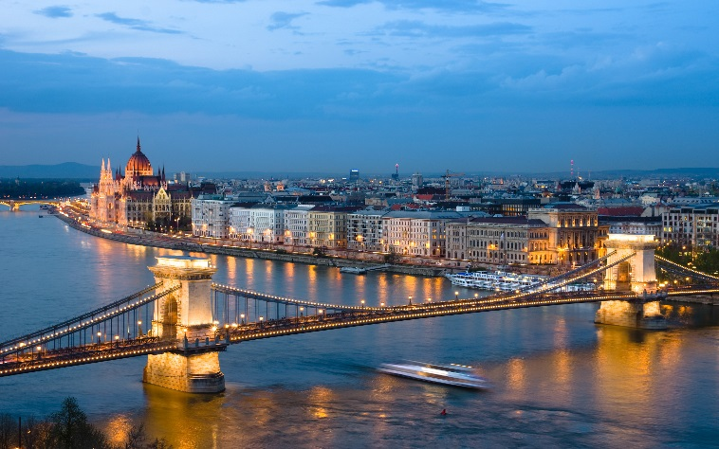
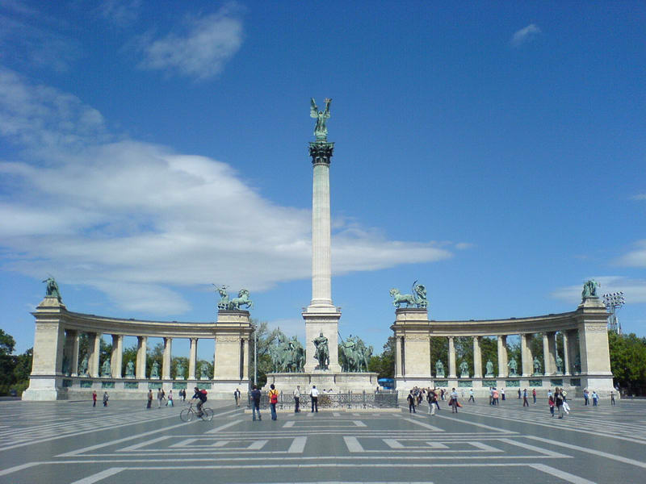
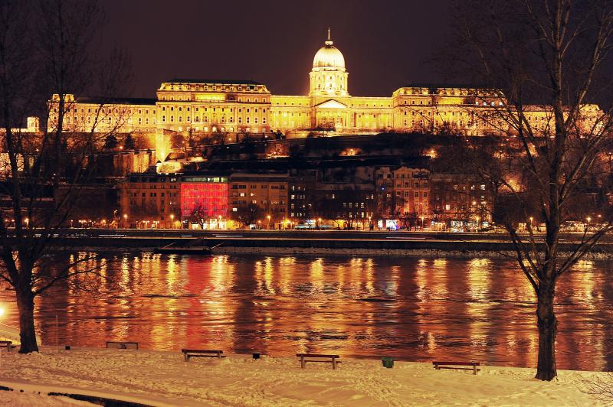
The Place
Budapest, one of the most interesting cities in the heart of Europe
The one of the largest schools in Budapest

Slide 3
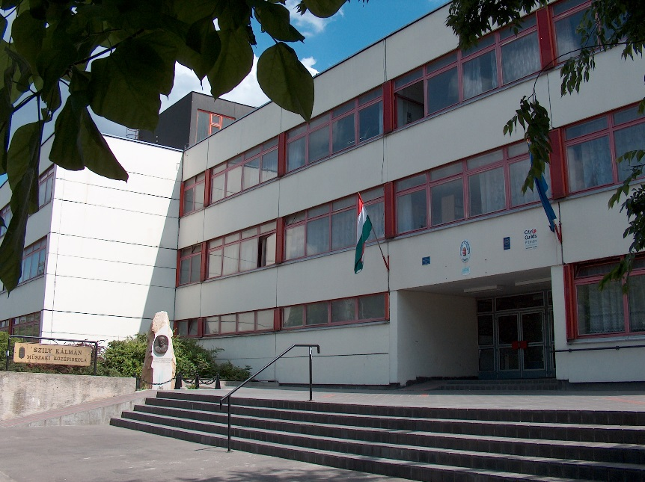
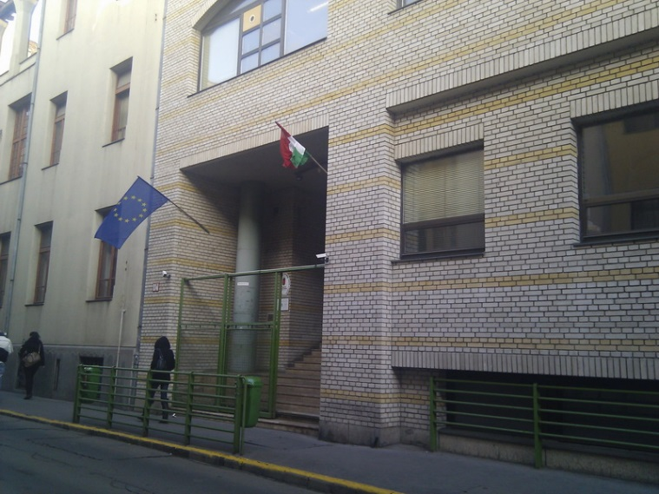
At present – Two places in Budapest
Timót street - the home of school in the 9th district of Budapest
school building (~ 700-800 student)
dormitory building (180 residentials, boys & girls)sport fields
workshops (~ 200 students)
Tolnai street - the site of school is in the heart of the cityschool
building (~100 students)
printing house

Slide 4
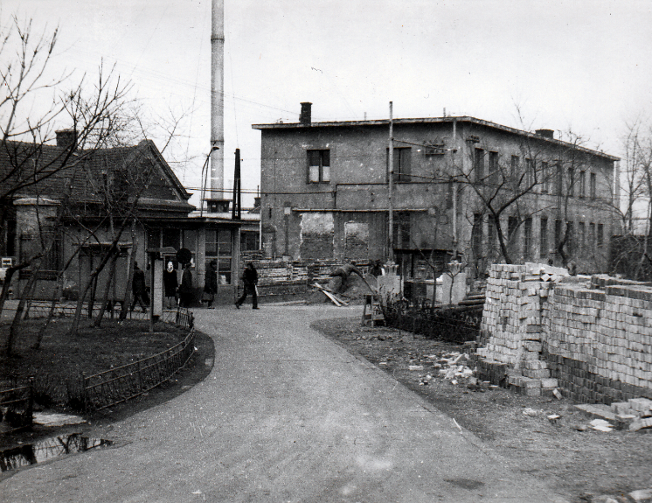
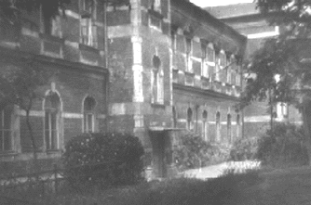
The Past
Founded in 1952, 7 years after the 2nd World War on the site of an army base

Slide 5
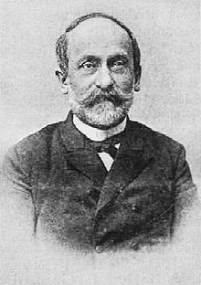
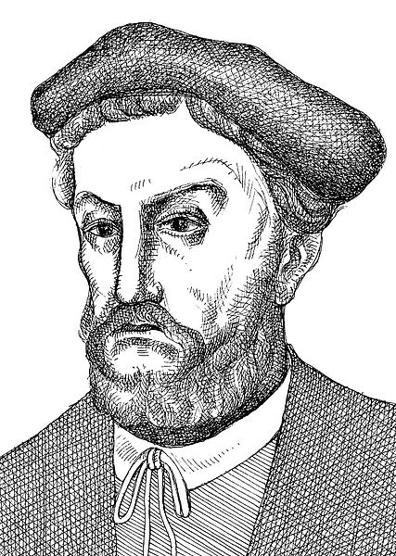
Szily Kálmán (1838 – 1924)
Polihistor
Scientist
Minister
Tótfalusi Kis Miklós (1650 -1702)
Typographer
pressman

Slide 6
Principles
Child centered
family athmosphere
modern, professional education
Culture
Traditions
international

Slide 7
Friendly, child centred school

Slide 8
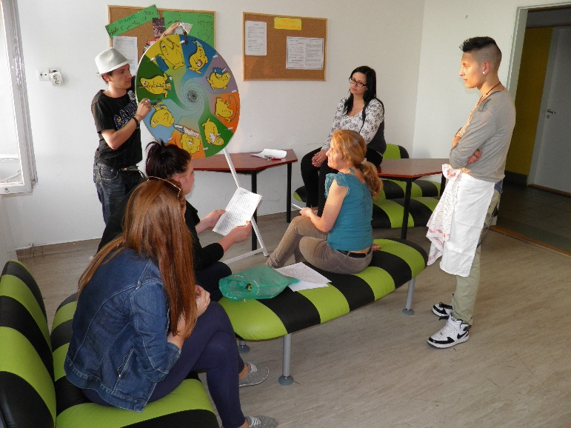
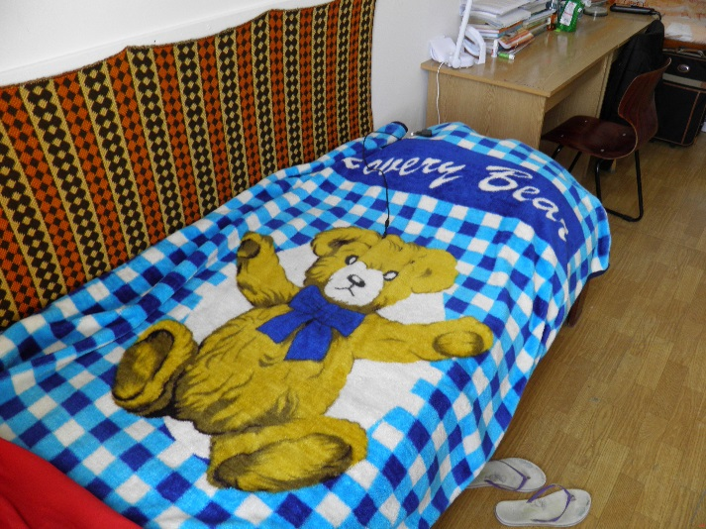
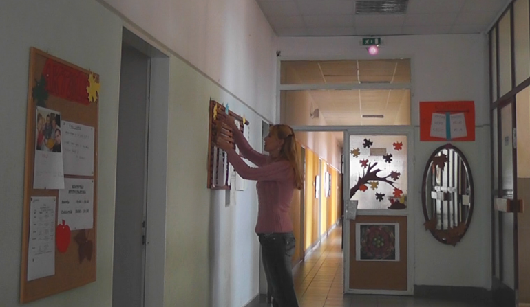
Family athmospehre Dormitory

Slide 9
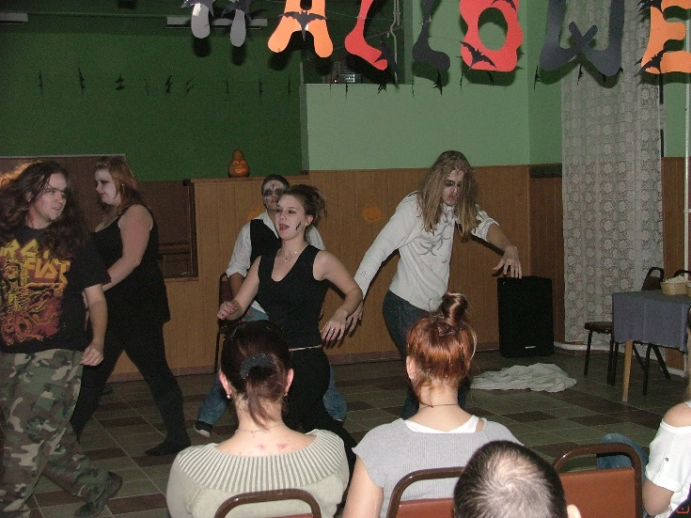
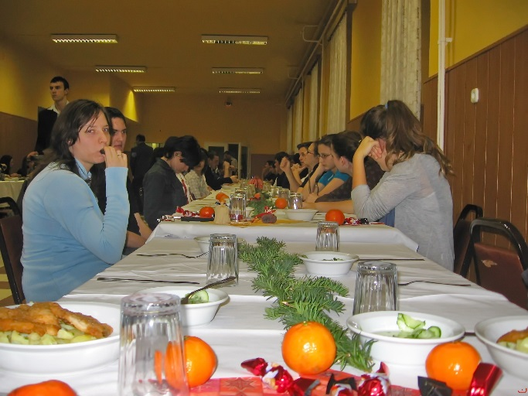
Familiar
Halloween party
Easter feast
Christmas lunch

Slide 10
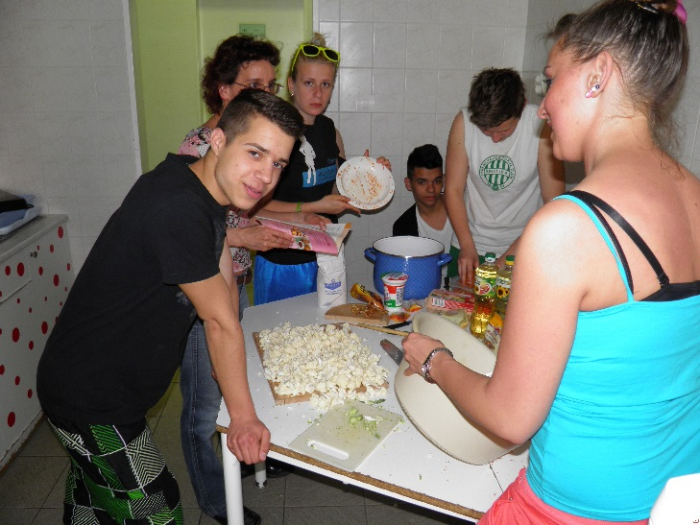
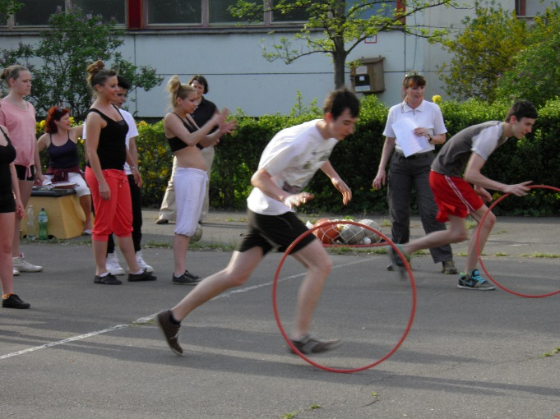
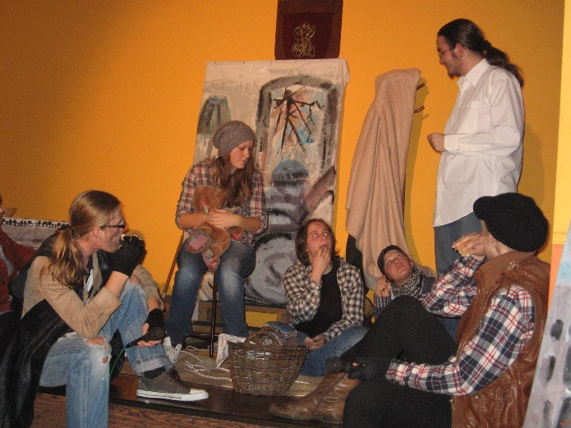
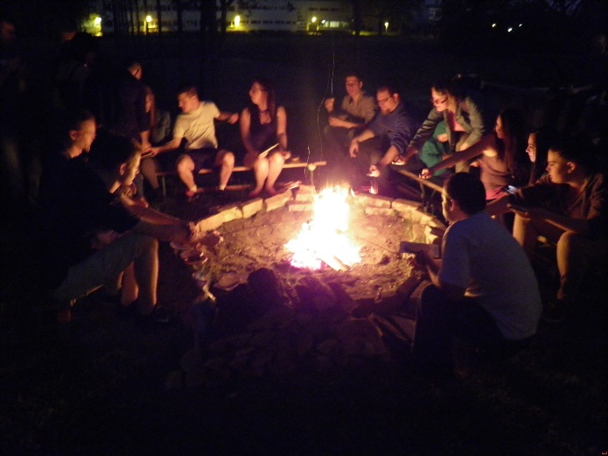
Activities

Slide 11
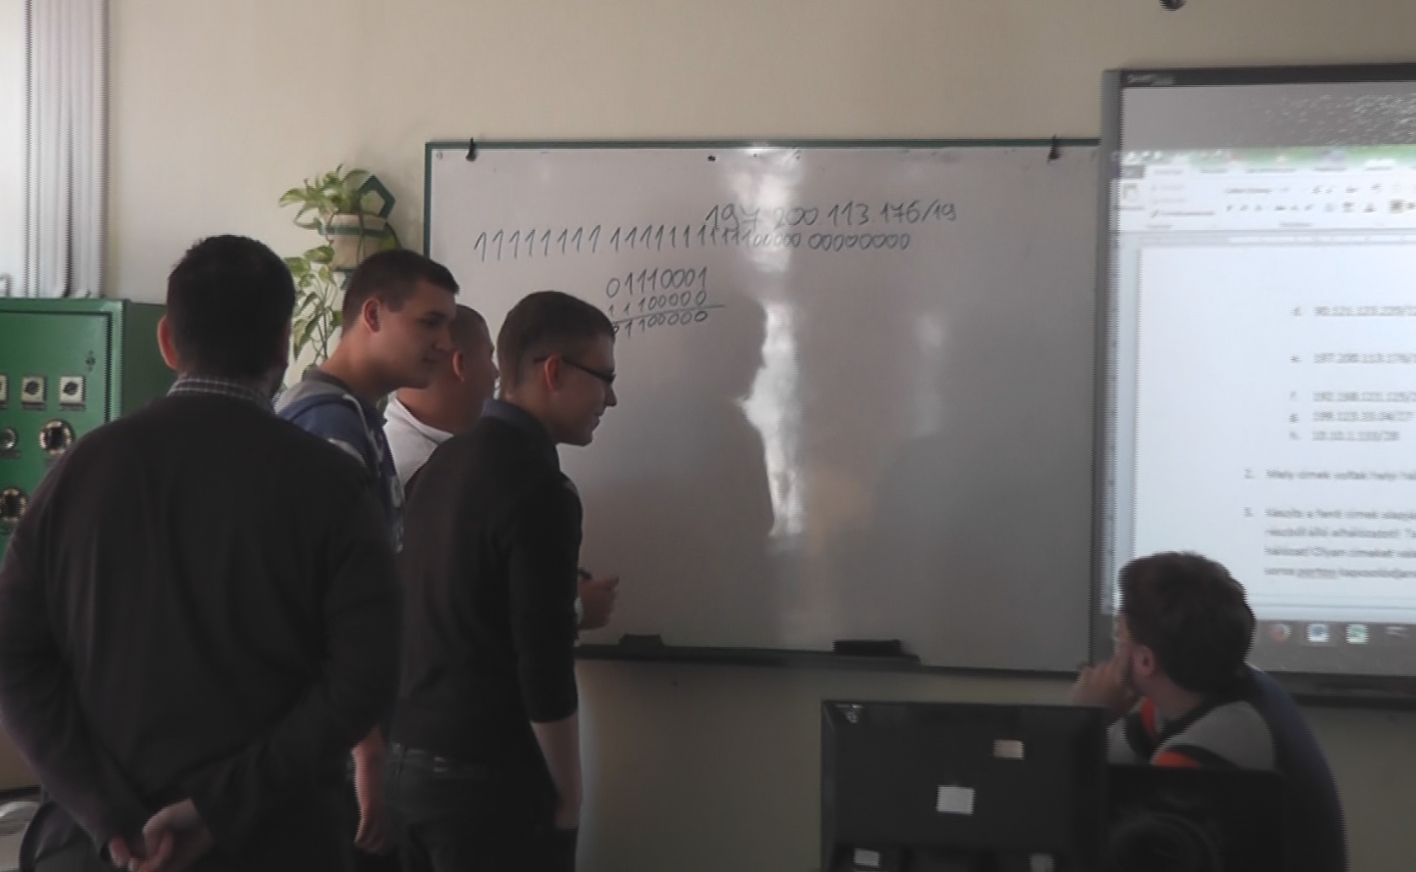
Education
vocational studies
profession and final exam
continuing studies at university
adult training

Slide 12
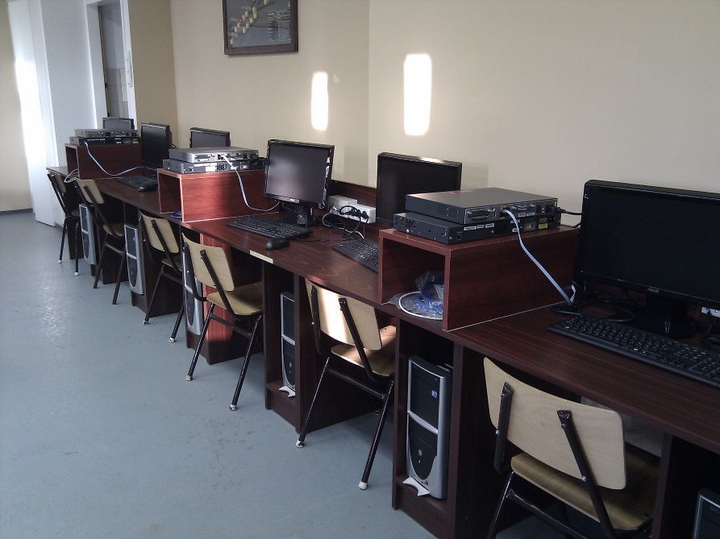
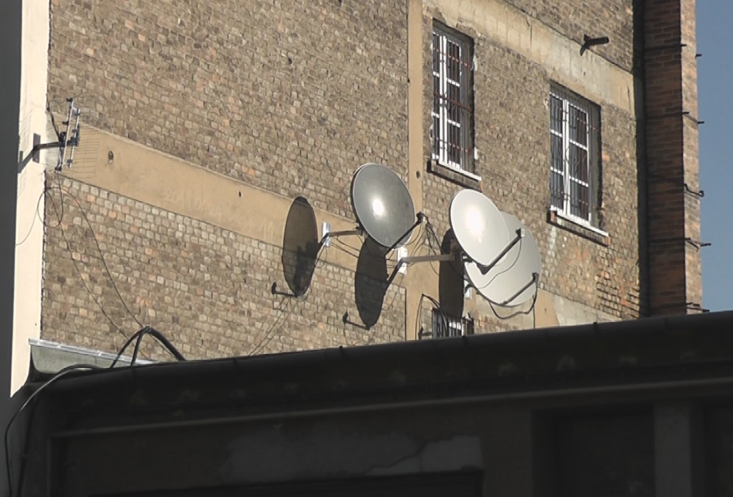
Trades
Timót street
In Workshops
mechanics
engineering
mechatronics
electronics
School
Informatics
Telecommunication
Tolnai street
printing – publishing

Slide 13
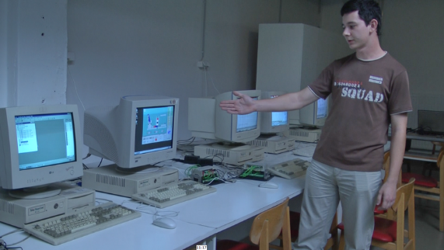
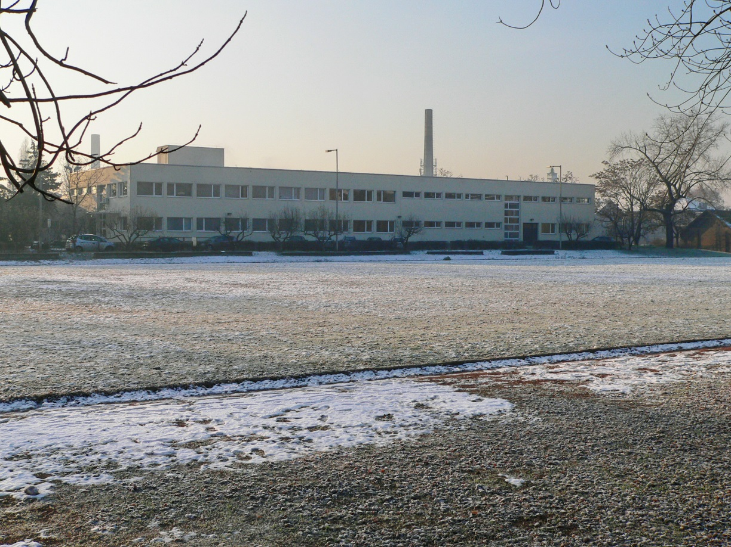
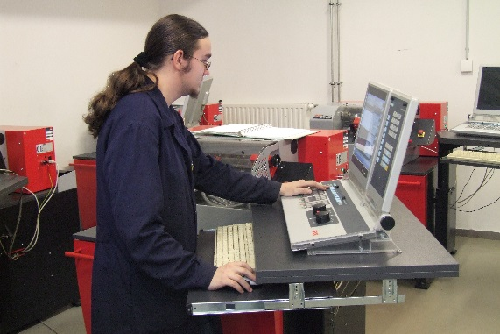
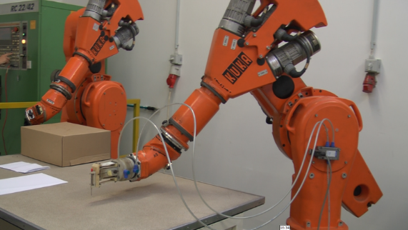
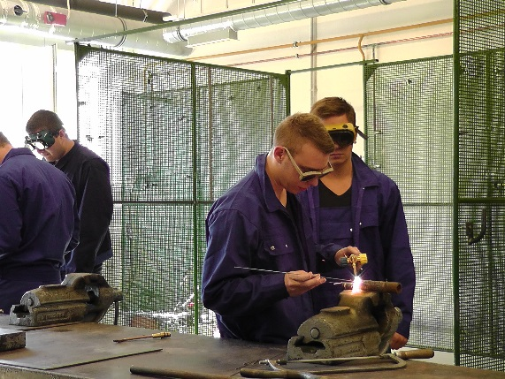
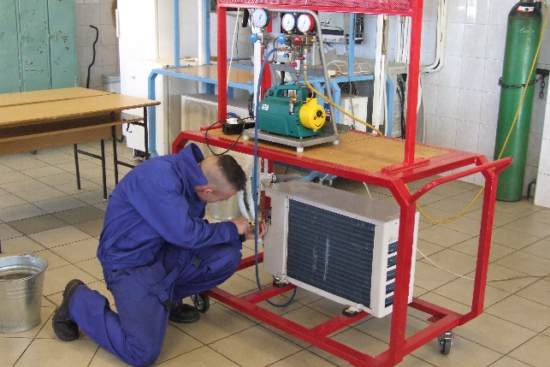
Practical training – in the Workshops

Slide 14
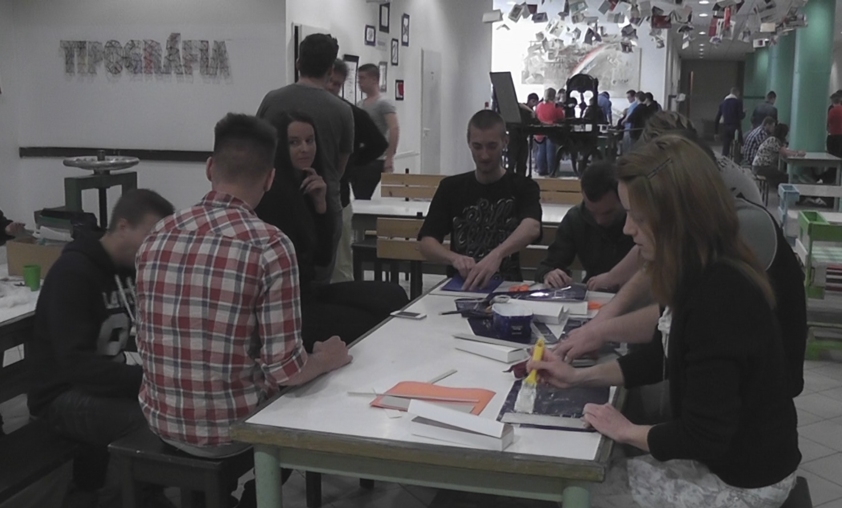
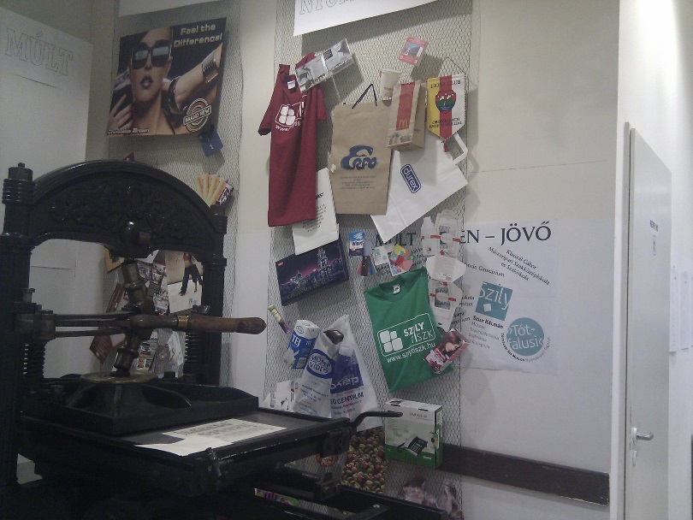
Printing – in Tolnai street

Slide 15
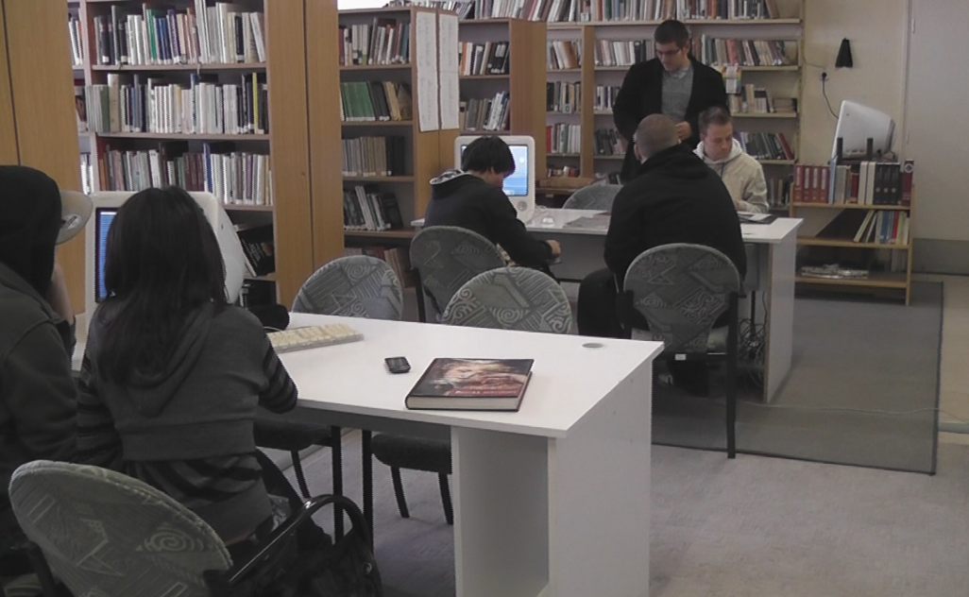
Culture
library
Literary competition

Slide 16
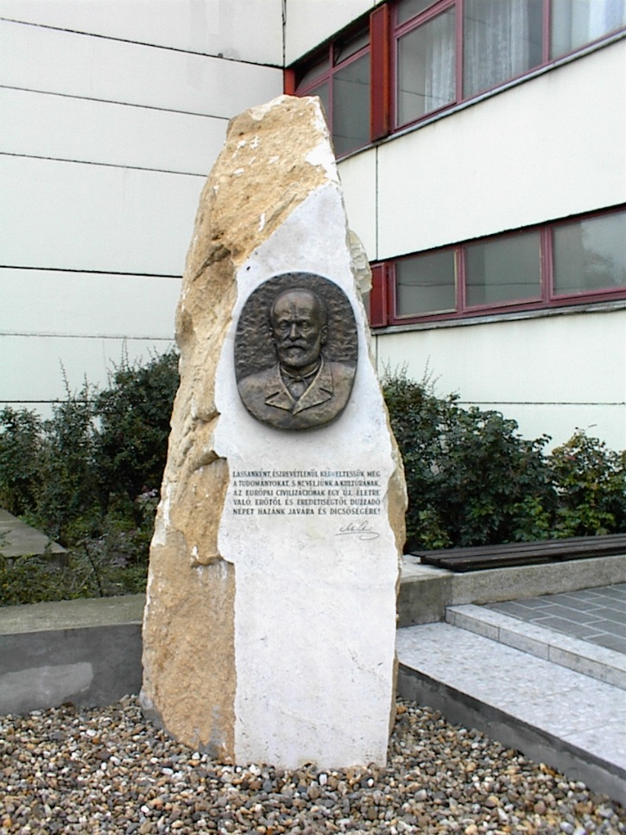
Traditions
School leavers' ball
School days
School leaving ceremony
School trip

Slide 17
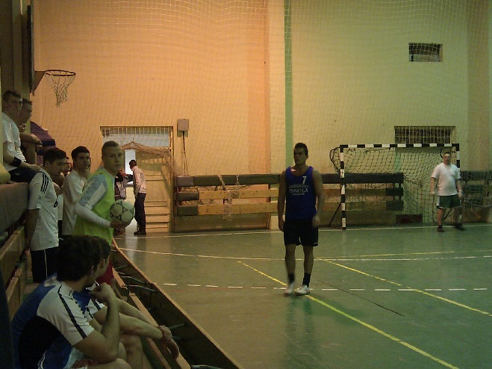
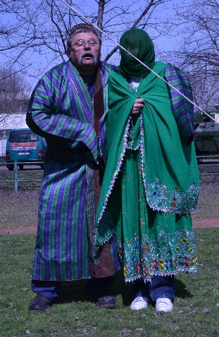
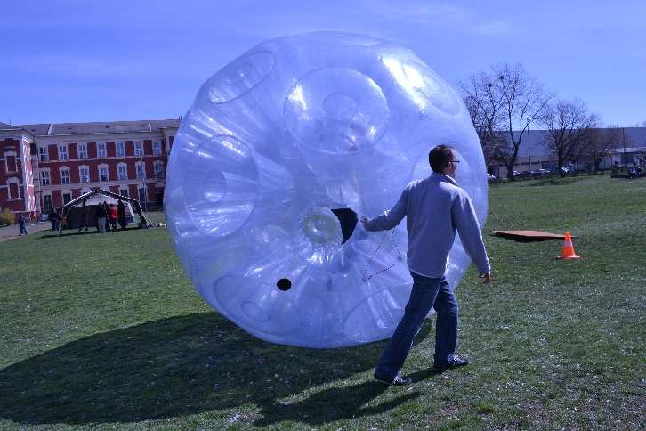
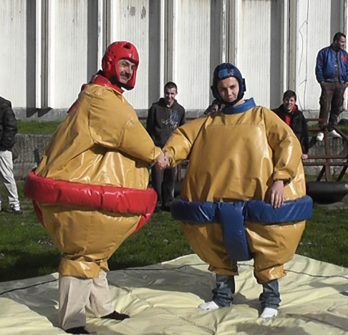
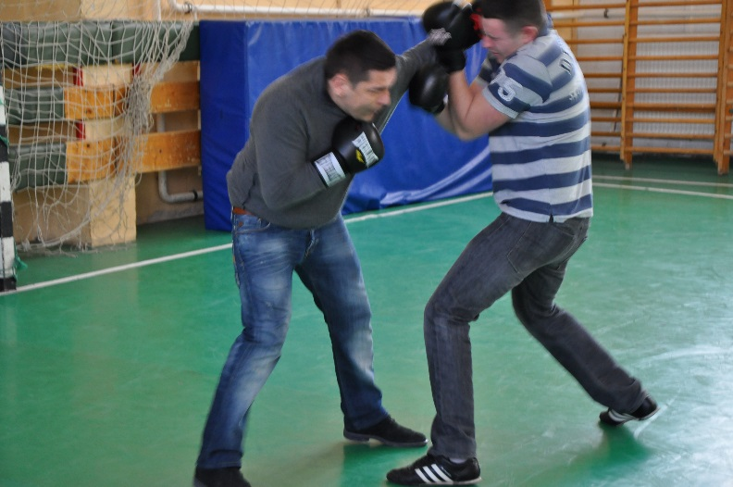
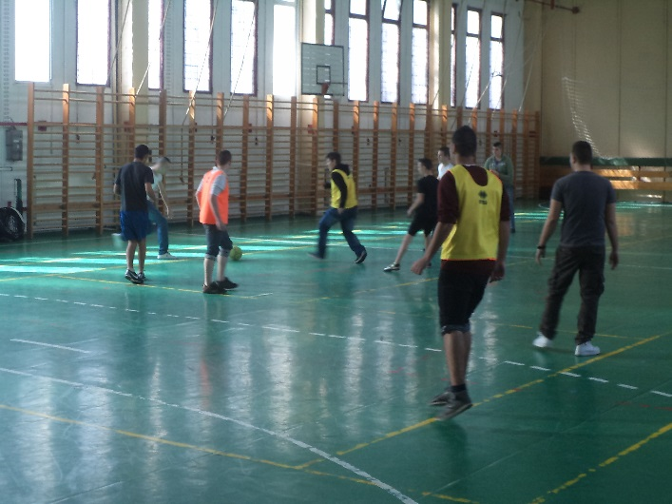
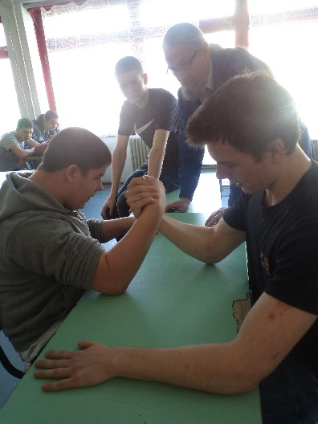
School Days
Nightly sport & LAN party
Sport, culture, playing

Slide 18
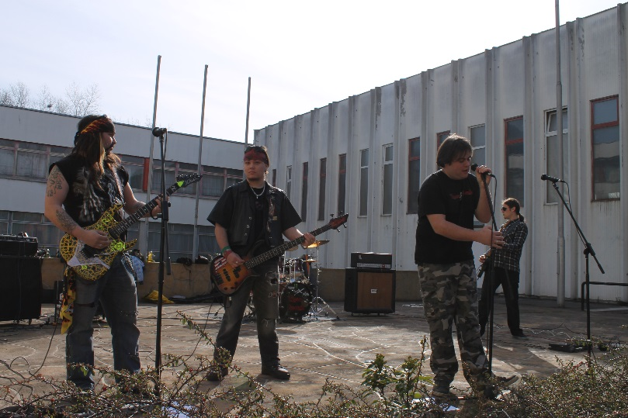
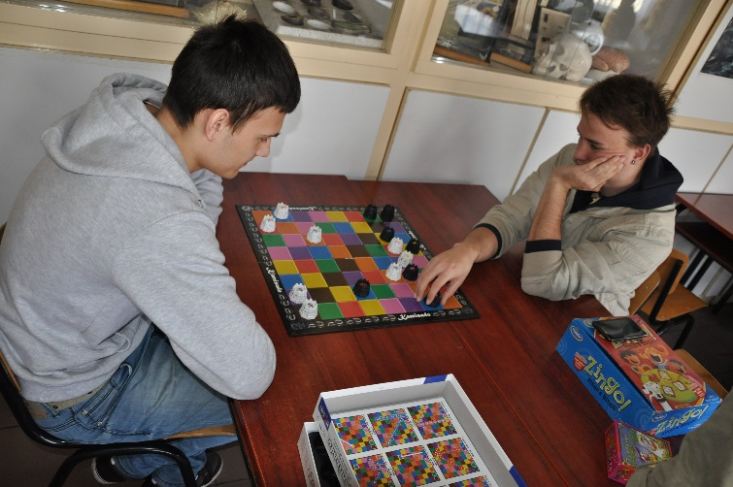
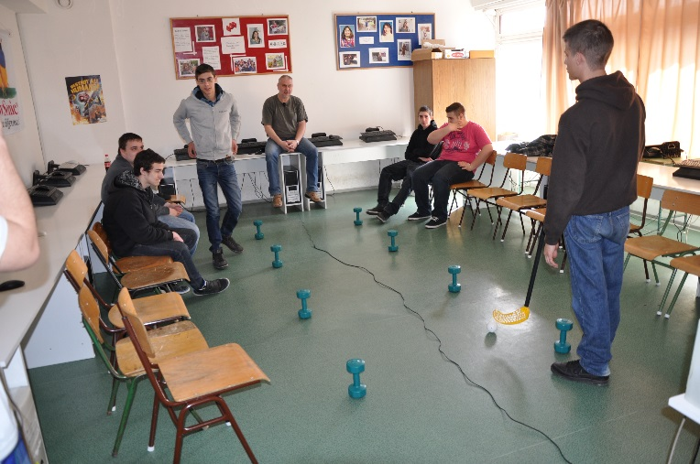
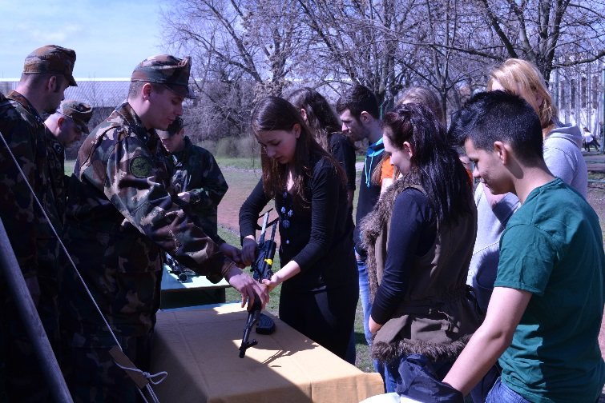
School Days
Playing
Make music
Play with guns

Slide 19
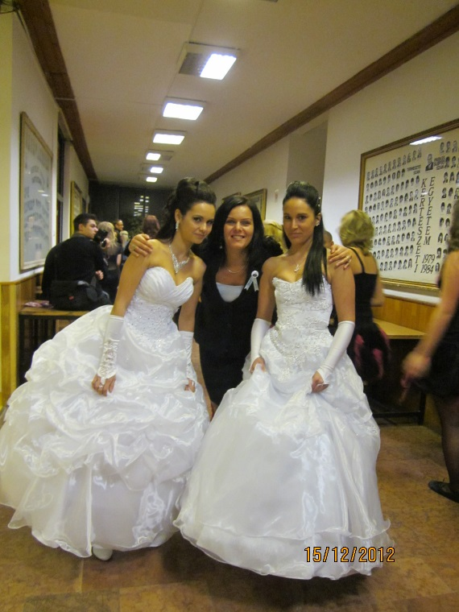
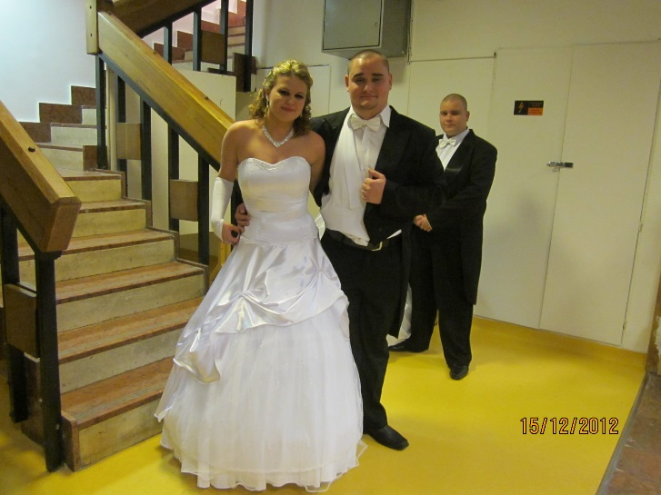
School leavers’ ball

Slide 20
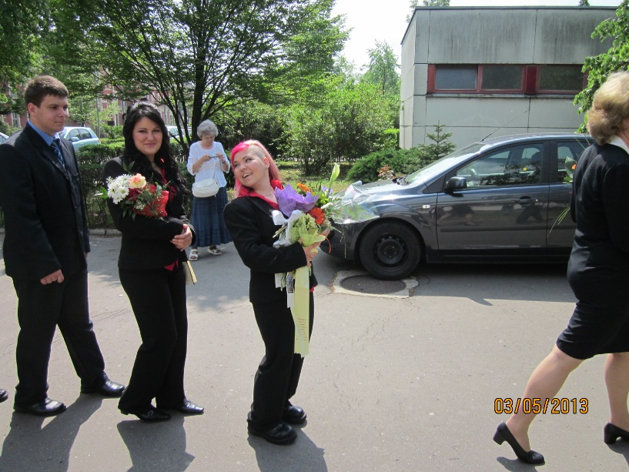
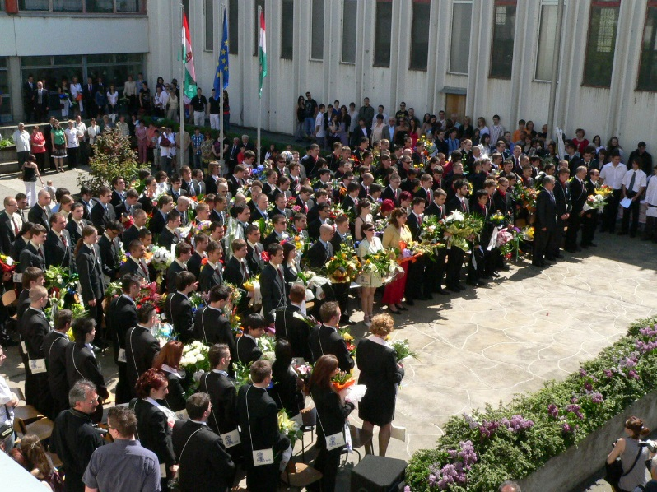
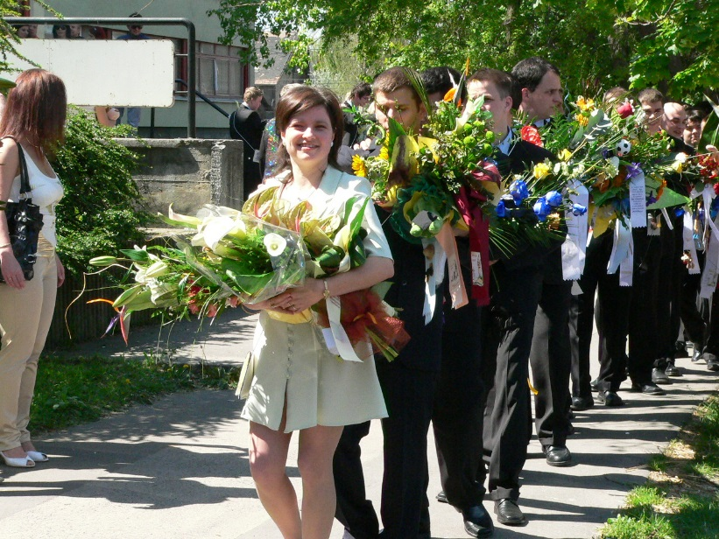
School leaving ceremony

Slide 21
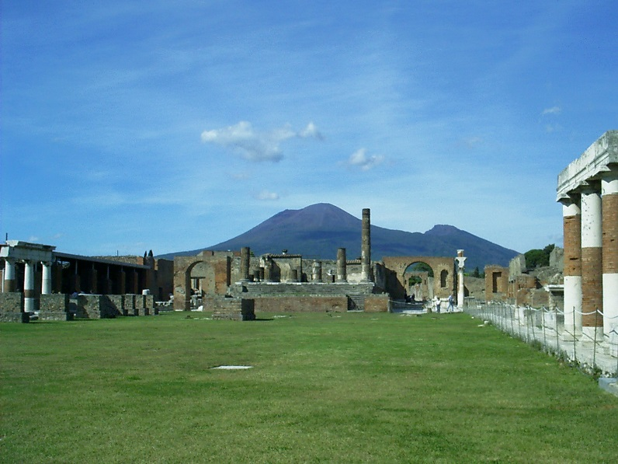
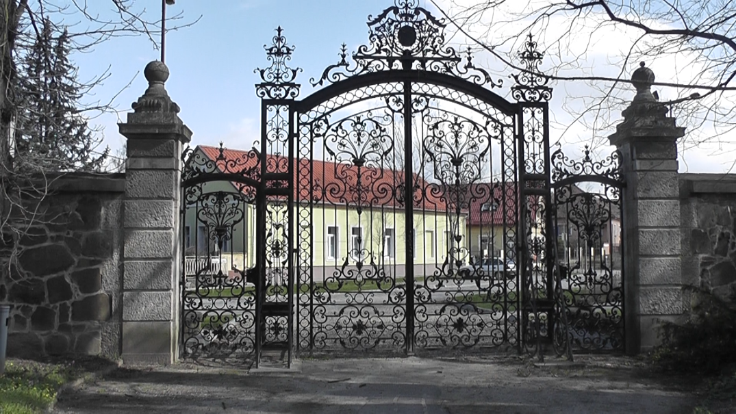
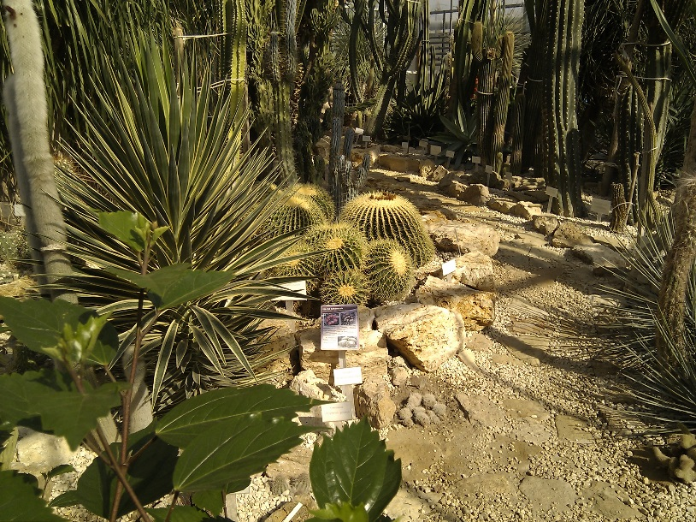
Trips
Italy
Hungary
Ski camp – in Slovakie
Arboretum near Vác

Slide 22
International relations / cooperation
We think it is very important for students
There are projects
Leonardo - Austria, Germany, Poland
Czech Republic - international competitions
Comenius - Greece, Italy, Portugal, Romania, Spain, Turkey

Slide 23
Thank You for Attention!

